Slide 1
Control Structures II (REPETITION OR ITERATION OR LOOPING)

Slide 2
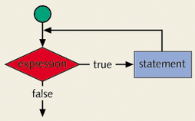
CONCEPT OF LOOPING (REPETITION) STRUCTURE
One of the basic structured programming concepts
The real power of computers is in their ability to repeat an operation or a series of operations many times
When action is repeated many times, the flow is called a loop

Slide 3
WHY IS REPETITION NEEDED?
Suppose we want to add five numbers (say to find their average).
From what you have learned so far, you could proceed as follows.
  scanf(%d %d %d %d %d, &num1,&num2,&num3,&num4,&num5);
  sum = num1+num2+num3+num4+num5;
  average = sum/5;
Suppose we wanted to add and average 100, or 1000, or more numbers.
We would have to declare that many variables, and list them again in scanf statement, and perhaps, again in the output statement.

Slide 4
SEQUENCE PROGRAM
Suppose the numbers we want to add are the following:
5 3 7 9 4
Consider the following statements
  (1) sum = 0;
  (2) scanf(%d,&num);
  (3) sum = sum + num;
Assume sum and num are variables of the type int.
The first statement initializes sum to 0.
Execute statements 2 and 3.
Statement 2 stores 5 in num and statement 3 updates the value of sum by adding num to it.
After statement 3 the value of sum is 5.

Slide 5
SEQUENCE PROGRAM
To add 10 numbers, you can repeat statements 2 and 3 10 times.
To add 100 numbers we can repeat statements 2 and 3 100 times.
You would not have to declare any addition variables as in the first code.
There are three repetition or looping structures in C that lets us repeat statements over and over until certain conditions are met.
  while Looping Structure
  for Looping Structure
  do…while Looping Structure

Slide 6
WHAT IS A LOOP
Loops repeat a statement, a block, a function or a set of any combination of these construct a number of times
The figure on the left demonstrates the repetition process of the statement printf and a=a+1.
The question about the figure is that when this loop will stop?
The loop will never stop and will infinitely repeat these statements until the program is forced to quit by the user
a=0
print a
a=a+1
0 1 2 3 4 5 6 7 ……..?

Slide 7
WHAT IS A LOOP
A loop must be controlled by a condition or an event in order to limit the number of iterations and prevent infinite loops from occurring
The figure to the left shows a loop controlled by a condition.
If the condition is true the loop will go on repeating the statements otherwise it breaks the cycle and continues with the rest of the program
The condition can be any logical or relational expression in C language
a=0
print a
a=a+1
Cond
True
false

Slide 8
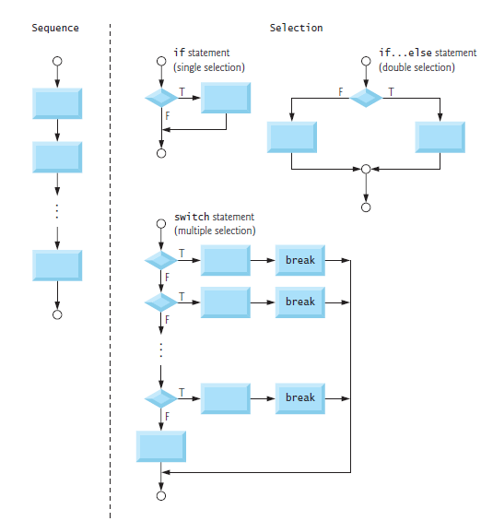
SELECTION STATEMENTS

Slide 9
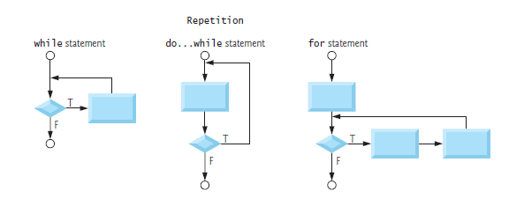
REPETITION STATEMENT

Slide 10
THE WHILE LOOPING (REPETITION) STRUCTURE
The general form of the while statement is
The statement can be either a simple or compound statement.
The statement is called the body of the loop.
The expression provides an entry condition.
while(expression)
statement

Slide 11
WHILE LOOPS
while ( expression )
{
loop body
}
while ( a>b )
{
}
while ( a>b && c<=78 )
{
}
while ( 1 )
{
}
The “loop body” can be either a simple or compound statement.
The “expression” provides an entry condition.
A while loop checks the expression before entering the loop body
The expression is evaluated first (must produce true or false) then if the value is true (none zero) the loop will continue otherwise it exits the loop body proceeding with the rest of the program.
This is an infinite
loop if 1 is true

Slide 12
WHILE LOOPS: EXAMPLES (1)
start
int main()
{
int count = 0;
while(count <= 5)
{
count = count + 1;
printf(“%d ”,count);
}
}
count = 0
count <= 5?
False
True
count = count + 1
output count
1 2 3 4 5 6
end

Slide 13
WHILE LOOPS: EXAMPLES (2)
start
int main()
{
int count, A, B;
scanf(“%d”,&A);
scanf(“%d”,&B);
count = A;
while(count <= B)
{
count = count + 1;
printf(“%d ”,count);
}
}
input A
input B
count = A
count <= B?
False
True
count = count + 1
output count
3 8
4 5 6 7 8 9
end

Slide 14
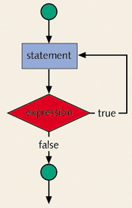
THE DO…WHILE LOOPING (REPETITION) STRUCTURE
The statement executes first, and then the expression is evaluated.
If the expression evaluates to true, the statement executes again.
As long as the expression in a do...while statement is true, the statement executes.
The general form of a do...while statement is:
do
statement
while(expression);

Slide 15
DO..WHILE LOOPS
do
{
loop body
} while ( expression );
do
{
} while ( a>b );
do
{
} while ( a>b && c<=7 );
do
{
} While ( 1 );
A do...while loop will allow the execution of the body once then checks the expression, if the expression is true then it will repeat again otherwise it exits the loop.
The expression is evaluated first (must produce true or false) then if the value is true (none zero) the loop will continue otherwise it exits the loop body proceeding with the rest of the program.
To avoid an infinite loop, make sure that the loop body contains a statement that ultimately makes the expression false and assures that it exits.
This is an infinite
loop if 1 is true

Slide 16
WHILE LOOP AND DO..WHILE LOOP
Loops in C language fall under two major categories, these are
  while , For loop
  The while loop, has the condition checked before entering the loop
  do while loop
  This type of loops will enter the loop body at least once then checks the condition
The two figures on the left show those two types
a=0
a=0
false
print a
Cond
True
a=a+1
print a
Cond
True
a=a+1
false
while
do while

Slide 17
DO…WHILE LOOPING STRUCTURE
Because the while and for loop has an entry condition, it may never activate, whereas, the do...while loop, which has an exit condition, always goes through at least once.
i = 11; while(i <= 10) { printf(“%d “,i); i++; } In the while loop, produces nothing. |  | i = 11; do { printf(“%d “,i); i++; } while(i <= 10); the do...while loop, outputs the number 11.

Slide 18
DO WHILE EXAMPLE(3)
start
int main()
{
int count = 0;
do
{
count = count + 1;
printf(“%d ”,count);
} while(count <= 5);
}
count = 0
count = count + 1
output count
count <= 5?
True
1 2 3 4 5 6
False
end

Slide 19
DO WHILE EXAMPLE(4)
start
int main()
{
int count, A, B;
scanf(“%d”,&A);
scanf(“%d”,&B);
count = A;
do
{
count = count + 1;
printf(“%d ”,count);
} while(count <= B)
}
input A
input B
count = A
output count
count = count + 1
count <= B?
True
3 8
4 5 6 7 8 9
False
end

Slide 20
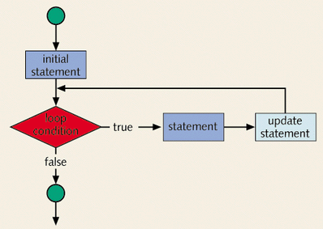
THE FOR LOOPING (REPETITION) STRUCTURE
The general form of the for statement is
for(initial statement; loop condition; update statement)
statement
The initial statement, loop condition and update statement (called for loop control statements) that are enclosed with in the parentheses controls the body (the statement) of the for statement.

Slide 21
FOR LOOPING STRUCTURE
The for loop executes as follows:
  The initial statement executes.
  The loop condition is evaluated. If the loop condition evaluates to true
    Execute the for loop statement.
    Execute the update statement.
  Repeat Step 2 until the loop condition evaluates to false.
The initial statement
  usually initializes a variable
  is the first statement to be executed and is executed only once.

Slide 22
THE FOR LOOPING (REPETITION) STRUCTURE
Problem: print numbers 1 through 10 on standard output
Solution using for statement
1 2 3 4 5 6 7 8 9 10
int counter;
for (counter = 1; counter <= 10; counter++)
printf(“%d ”,counter);
control
variable
limiting value of
control variable
for (counter = 1; counter <= 10; counter++)
for
keyword
initial value of
control variable
updating
control variable

Slide 23
FOR LOOPING STRUCTURE
The statement of a for loop may be a simple or a compound statement.
simple | compound
for(i = 1; i <= 5; i++) printf("Output of stars.\n“); printf("*“); | for(i = 1; i <= 5; i++) { printf("Output of stars.\n“); printf("*\n“); }
Output a line of stars.
Output a line of stars.
Output a line of stars.
Output a line of stars.
Output a line of stars.
*
Output a line of stars.
*
Output a line of stars.
*
Output a line of stars.
*
Output a line of stars.
*
Output a line of stars.
*
for(i = 1; i <= 5; i++);
printf("*“);
*

Slide 24
FOR LOOPING STRUCTURE
All three statements can be omit—initial statement, loop condition, and update statement.
for(;;)
printf("Hello\n“);
Count backward
for(i = 10; i >= 1; i--)
printf(“%d “,i);
Increment (or decrement) the loop control variable
for(i = 1; i <= 20; i = i + 2)
printf(“%d “,i);
Hello
Hello
.
.
Infinite output; press break to stop the program running
10 9 8 7 6 5 4 3 2 1
1 3 5 7 9 11 13 15 17 19

Slide 25
FOR LOOPING STRUCTURE
Example 5
// reads five numbers and find their sum and average
#include <stdio.h>
int main()
{
int i, newNum, sum, average;
sum = 0;
for(i = 1; i <= 5; i++)
{
scanf(“%d”,&newNum);
sum = sum + newNum;
}
average = sum / 5;
printf("The sum is %d\n”,sum);
printf(“The average is %d”,average);
return 0;
}
5 4 3 2 1
The sum is 15
The average is 3

Slide 26
3.8 FORMULATING ALGORITHMS
(COUNTER-CONTROLLED REPETITION)
Counter-controlled repetition
  Loop repeated until counter reaches a certain value
  Definite repetition: number of repetitions is known
  Example: A class of ten students took a quiz. The grades (integers in the range 0 to 100) for this quiz are available to you. Determine the class average on the quiz
  Pseudocode:
    Set total to zero
    Set grade counter to one
    While grade counter is less than or equal to ten
    Input the next grade
    Add the grade into the total
    Add one to the grade counter
    Set the class average to the total divided by ten
    Print the class average

Slide 27
1 /* Fig. 3.6: fig03_06.c
2 Class average program with
3 counter-controlled repetition */
4 #include <stdio.h>
1. Initialize Variables
2. Execute Loop
3. Output results
5
6 int main()
7 {
8 int counter, grade, total, average;
9
10 /* initialization phase */
11 total = 0;
12 counter = 1;
13
14 /* processing phase */
15 while ( counter <= 10 ) {
16 printf( "Enter grade: " );
17 scanf( "%d", &grade );
18 total = total + grade;
19 counter = counter + 1;
20 }
21
22 /* termination phase */
23 average = total / 10;
24 printf( "Class average is %d\n", average );
25
26 return 0; /* indicate program ended successfully */
27 }

Slide 28
Enter grade: 98
Enter grade: 76
Enter grade: 71
Enter grade: 87
Enter grade: 83
Enter grade: 90
Enter grade: 57
Enter grade: 79
Enter grade: 82
Enter grade: 94
Class average is 81
Program Output

Slide 29
3.9 FORMULATING ALGORITHMS WITH TOP-DOWN, STEPWISE REFINEMENT
Problem becomes:
  Develop a class-averaging program that will process an arbitrary number of grades each time the program is run.
  Unknown number of students
  How will the program know to end?
Use sentinel value
  Also called signal value, dummy value, or flag value
  Indicates “end of data entry.”
  Loop ends when user inputs the sentinel value
  Sentinel value chosen so it cannot be confused with a regular input (such as -1 in this case)

Slide 30
3.9 FORMULATING ALGORITHMS WITH TOP-DOWN, STEPWISE REFINEMENT
Top-down, stepwise refinement
  Begin with a pseudocode representation of the top:
    Determine the class average for the quiz
  Divide top into smaller tasks and list them in order:
    Initialize variables
    Input, sum and count the quiz grades
    Calculate and print the class average
Many programs have three phases:
  Initialization: initializes the program variables
  Processing: inputs data values and adjusts program variables accordingly
  Termination: calculates and prints the final results

Slide 31
3.9 FORMULATING ALGORITHMS WITH TOP-DOWN, STEPWISE REFINEMENT
Refine the initialization phase from Initialize variables to:
    Initialize total to zero
    Initialize counter to zero
Refine Input, sum and count the quiz grades to
    Input the first grade (possibly the sentinel)
    While the user has not as yet entered the sentinel
    Add this grade into the running total
    Add one to the grade counter
    Input the next grade (possibly the sentinel)

Slide 32
3.9 FORMULATING ALGORITHMS WITH TOP-DOWN, STEPWISE REFINEMENT
Refine Calculate and print the class average to
    If the counter is not equal to zero
    Set the average to the total divided by the counter
    Print the average
    else
    Print “No grades were entered”

Slide 33
1 /* Fig. 3.8: fig03_08.c
2 Class average program with
3 sentinel-controlled repetition */
4 #include <stdio.h>
1. Initialize Variables
2. Get user input
2.1 Perform Loop
5
6 int main()
7 {
8 float average; /* new data type */
9 int counter, grade, total;
10
11 /* initialization phase */
12 total = 0;
13 counter = 0;
14
15 /* processing phase */
16 printf( "Enter grade, -1 to end: " );
17 scanf( "%d", &grade );
18
19 while ( grade != -1 ) {
20 total = total + grade;
21 counter = counter + 1;
22 printf( "Enter grade, -1 to end: " );
23 scanf( "%d", &grade );
24 }

Slide 34
25
26 /* termination phase */
27 if ( counter != 0 ) {
28 average = ( float ) total / counter;
3. Calculate Average
3.1 Print Results
Program Output
29 printf( "Class average is %.2f", average );
30 }
31 else
32 printf( "No grades were entered\n" );
33
34 return 0; /* indicate program ended successfully */
35 }
Enter grade, -1 to end: 75
Enter grade, -1 to end: 94
Enter grade, -1 to end: 97
Enter grade, -1 to end: 88
Enter grade, -1 to end: 70
Enter grade, -1 to end: 64
Enter grade, -1 to end: 83
Enter grade, -1 to end: 89
Enter grade, -1 to end: -1
Class average is 82.50

Slide 35
3.10 NESTED CONTROL STRUCTURES
Problem
  A college has a list of test results (1 = pass, 2 = fail) for 10 students
  Write a program that analyzes the results
    If more than 8 students pass, print "Raise Tuition"
Notice that
  The program must process 10 test results
    Counter-controlled loop will be used
  Two counters can be used
    One for number of passes, one for number of fails
  Each test result is a number—either a 1 or a 2
    If the number is not a 1, we assume that it is a 2

Slide 36
3.10 NESTED CONTROL STRUCTURES
Top level outline
    Analyze exam results and decide if tuition should be raised
First Refinement
    Initialize variables
    Input the ten quiz grades and count passes and failures
    Print a summary of the exam results and decide if tuition should be raised
Refine Initialize variables to
    Initialize passes to zero
    Initialize failures to zero
    Initialize student counter to one

Slide 37
3.10 NESTED CONTROL STRUCTURES
Refine Input the ten quiz grades and count passes and failures to
    While student counter is less than or equal to ten
    Input the next exam result
    If the student passed
    Add one to passes
    else
    Add one to failures
    Add one to student counter
Refine Print a summary of the exam results and decide if tuition should be raised to
    Print the number of passes
    Print the number of failures
    If more than eight students passed
    Print “Raise tuition”

Slide 38
1 /* Fig. 3.10: fig03_10.c
2 Analysis of examination results */
3 #include <stdio.h>
4
1. Initialize variables
2. Input data and count passes/failures
3. Print results
5 int main()
6 {
7 /* initializing variables in declarations */
8 int passes = 0, failures = 0, student = 1, result;
9
10 /* process 10 students; counter-controlled loop */
11 while ( student <= 10 ) {
12 printf( "Enter result ( 1=pass,2=fail ): " );
13 scanf( "%d", &result );
14
15 if ( result == 1 ) /* if/else nested in while */
16 passes = passes + 1;
17 else
18 failures = failures + 1;
19
20 student = student + 1;
21 }
22
23 printf( "Passed %d\n", passes );
24 printf( "Failed %d\n", failures );
25
26 if ( passes > 8 )
27 printf( "Raise tuition\n" );
28
29 return 0; /* successful termination */
30 }

Slide 39
Enter Result (1=pass,2=fail): 1
Enter Result (1=pass,2=fail): 2
Enter Result (1=pass,2=fail): 2
Enter Result (1=pass,2=fail): 1
Enter Result (1=pass,2=fail): 1
Enter Result (1=pass,2=fail): 1
Enter Result (1=pass,2=fail): 2
Enter Result (1=pass,2=fail): 1
Enter Result (1=pass,2=fail): 1
Enter Result (1=pass,2=fail): 2
Passed 6
Failed 4
Program Output

Slide 40
BREAK STATEMENT
A break and continue statement alters the flow of control.
The break statement, when executed in a switch structure, provides an immediate exit from the switch structure.
You can use the break statement in while, for, and do...while loops.
When the break statement executes in a repetition structure, it immediately exits from these structures.
The break statement is typically used for two purposes:
  To exit early from a loop
  To skip the remainder of the switch structure
After the break statement executes, the program continues to execute with the first statement after the structure.

Slide 41
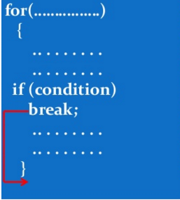
LOOPS AND BREAK KEYWORD
int i;
for(i=1;i<=10;i++)
{
if(i==3)
{
break;
}
printf(“%d\t”,i);
}

Slide 42
CONTINUE STATEMENT
The continue statement is used in while, for, and do-while structures.
When the continue statement is executed in a loop, it skips the remaining statements in the loop and proceeds with the next iteration of the loop.
In a while and do-while structure, the expression (that is, the loop-continue test) is evaluated immediately after the continue statement.
In a for structure, the update statement is executed after the continue statement, and then the loop condition (that is, the loop-continue test) executes.

Slide 43
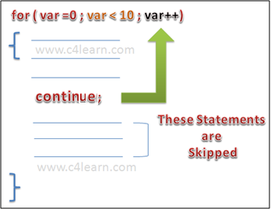
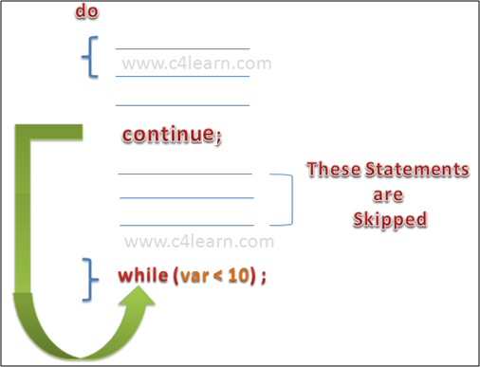
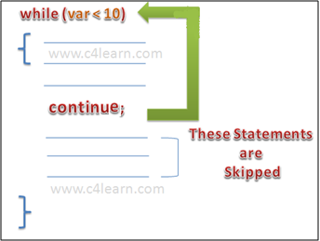
CONTINUE STATEMENT
int i;
for(i=1;i<=10;i++)
{
if((i==3)||(i==7))
{
continue;
}
printf(“%d\t”,i);
}

Slide 44
NESTED LOOPING
A loop (e.g., while, do-while, for) can be placed within the body of another loop.
When one loop is nested within another, several iterations of the inner loop are performed for every single iteration of the outer loop.
The inner and outer loops need not to be generated by the same type of control structures.

Slide 45

NESTED FOR LOOP (EXAMPLE 6)
for ( expr1a; expr2a; expr3a )
{
:
for ( expr1b; expr2b; expr3b )
{
:
}
:
}
#include<stdio.h>
int main()
{
int i,j;
for (i=1; i<=5;i++) //Line 1
{
for (j=1;j<=i;j++) //Line 2
{
printf("*"); //Line 3
}
printf("\n"); //Line 4
}
}

Slide 46
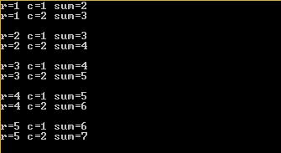
NESTED WHILE (EXAMPLE 7)
#include<stdio.h>
int main()
{
int r,c,s;
r=1;
while(r<=5) /*outer loop*/
{
c=1;
while(c<=2) /*inner loop*/
{
s=r+c;
printf("r=%d c=%d sum=%d\n",r,c,s);
c++;
}
printf("\n");
r++;
}
}
while (expr1)
{
:
while (expr2)
{
:
Update expr2;
}
:
update expr1;
}

Slide 47
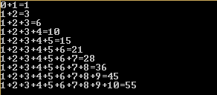
NESTED DO WHILE (EXAMPLE 8)
#include<stdio.h>
int main()
{
int i=1,j=0,sum;
do {
sum=0;
do{
sum=sum+j;
printf("%d",j);
j++;
if(j<=i)
{
printf("+");
}
}while(j<=i);
printf("=%d\n",sum);
j=1;
i++;
}while(i<=10);
}
do
{
:
do
{
:
Update expr;
}
while(expr);
:
update expr;
}
while(expr);

Slide 48
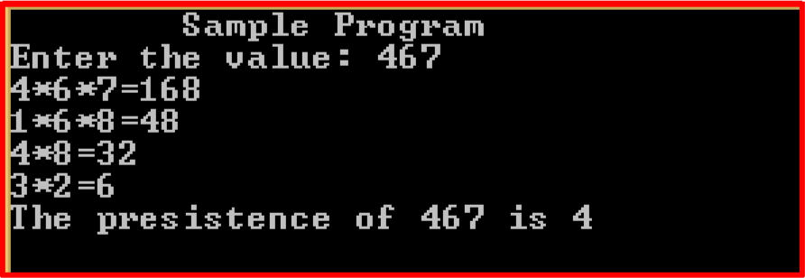
EXERCISES
Find the persistence of a number. It is the number, if times you can multiple the digits (iteratively) before you get a single digit number.

Slide 49
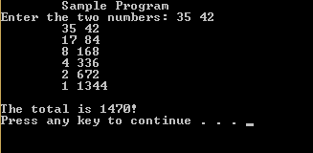
Given two numbers multiply them using the following method. Successively divide the smaller number by 2 (ignore any remainder) until the quotient is 1 and multiple the larger number by 2. Add to a total only those multiples of the larger which correspond to an odd quotient of the smaller.

Slide 50
Find the digital root of a number (repeatedly find the sum of the digits until you get a number 1 to 9.
285:
2+8+5=15
1+5=6
A ball is dropped from a height of x. It decreases 2/3 on height x at each bounce. How many bounces the ball will have until height is less than y? (Use while loop and if condition to break, when height x becomes less than y).

Slide 51
Write a C program that receives the total number of integers (N). Then, the program will ask for N real numbers. By applying for loop, your program should find and display the largest and the lowest of the numbers. Give a proper message for invalid user input (Don’t use arrays).

